Slide 1
Vulnerability Report on zero.webappsecurity.com

Slide 2
Summary
While Performing Automated Vulnerability Scanning I found that zero.webappsecurity.com website has Out-of-date Version Apache.
The certainity of Out-of-date Version Apache Vulnerability is Critical.
It Consists of Vulnerabilities like OpenSSL Numeric Errors Vulnerability, OpenSSL Improper Input Validation Vulnerability, OpenSSL Inadequate Encryption Strength Vulnerability…etc.

Slide 3
Description
Domain : zero.webappsecurity.com
Vulnerability : Out-of-date Version (Apache)
Certainty | : Critical
URL | : https://zero.webappsecurity.com/
Identified Version | : 2.2.6
Latest Version | : 2.2.34 (in this branch)
Vulnerability Database | : Result is based on 10/14/2022 20:30:00 vulnerability database content.

Slide 4
Testing Environment
OS Version : Windows 11
Testing Tools Used : Net Sparker v5.8
Scan Policy : AIIOS (AllWebServer-AllAppServer Microsoft SQL Server-MYSQL-Oracle-PostgreSQL-Other)

Slide 5
Steps to Reproduce
To reproduce this, an attacker has to:
Firstly, Open Net Sparker
Enter Target Website URL
Change the Scan Policy to AIIOS (AllWebServer- AllAppServer-Microsoft SQL Server-MYSQL-Oracle-PostgreSQL-Other)
Click on Start Scan

Slide 6
Impact
Since this is an old version of the software, it may be vulnerable to attacks.
Known Vulnerabilities in this Version
OpenSSL Cryptographic Issues Vulnerability
The Cryptographic Message Syntax (CMS) implementation in crypto/cms/cms_asn1.c in OpenSSL before 0.9.8o and 1.x before 1.0.0a does not properly handle structures that contain OriginatorInfo, which allows context-dependent attackers to modify invalid memory locations.
OpenSSL Improper Authentication Vulnerability
OpenSSL before 1.0.0c, when J-PAKE is enabled, does not properly validate the public parameters in the J-PAKE protocol, which allows remote attackers to bypass the need for knowledge of the shared secret.

Slide 7
OpenSSL Resource Management Errors Vulnerability
The ephemeral ECDH ciphersuite functionality in OpenSSL 0.9.8 through 0.9.8r and 1.0.x before 1.0.0e does not ensure thread safety during processing of handshake messages from clients.
OpenSSL Improper Input Validation Vulnerability
The kssl_keytab_is_available function in ssl/kssl.c in OpenSSL before 0.9.8n, when Kerberos is enabled but Kerberos configuration files cannot be opened, does not check a certain return value, which allows remote attackers to cause a denial of service.
OpenSSL Improper Restriction of Operations within the Bounds of a Memory Buffer Vulnerability
The dtls1_buffer_record function in ssl/d1_pkt.c in OpenSSL 0.9.8k and earlier 0.9.8 versions allows remote attackers to cause a denial of service .

Slide 8
OpenSSL Numeric Errors Vulnerability
Off-by-one error in the SSL_get_shared_ciphers function in OpenSSL 0.9.7 up to 0.9.7l, and 0.9.8 up to 0.9.8f, might allow remote attackers to execute arbitrary code via a crafted packet that triggers a one-byte buffer underflow.
OpenSSL Improper Input Validation Vulnerability
OpenSSL before 0.9.8m does not check for a NULL return value from bn_wexpand function calls which has unspecified impact and context-dependent attack vectors.
OpenSSL Permissions, Privileges, and Access Controls Vulnerability
OpenSSL before 0.9.8l, and 0.9.8m through 1.x, does not properly restrict client-initiated renegotiation within the SSL and TLS protocols.

Slide 9
OpenSSL Inadequate Encryption Strength Vulnerability
OpenSSL before 0.9.8za, 1.0.0 before 1.0.0m, and 1.0.1 before 1.0.1h does not properly restrict processing of ChangeCipherSpec messages, which allows man-in-the-middle attackers to trigger use of a zero-length master key.
OpenSSL Exposure of Sensitive Information to an Unauthorized Actor Vulnerability
The ASN1_TFLG_COMBINE implementation in crypto/asn1/tasn_dec.c in OpenSSL before 0.9.8zh, 1.0.0 before 1.0.0t, 1.0.1 before 1.0.1q, and 1.0.2 before 1.0.2e mishandles errors caused by malformed X509_ATTRIBUTE data.
OpenSSL Improper Restriction of Operations within the Bounds of a Memory Buffer Vulnerability
The asn1_d2i_read_bio function in crypto/asn1/a_d2i_fp.c in OpenSSL before 0.9.8v, 1.0.0 before 1.0.0i, and 1.0.1 before 1.0.1a does not properly interpret integer data, which allows remote attackers to conduct buffer overflow attacks, and cause a denial of service

Slide 10
OpenSSL DEPRECATED: Code Vulnerability
The ASN1_item_ex_d2i function in crypto/asn1/tasn_dec.c in OpenSSL before 0.9.8zf, 1.0.0 before 1.0.0r, 1.0.1 before 1.0.1m, and 1.0.2 before 1.0.2a does not reinitialize CHOICE and ADB data structures, which might allow attackers to cause a denial of service.
OpenSSL Other Vulnerability
The mime_hdr_cmp function in crypto/asn1/asn_mime.c in OpenSSL 0.9.8t and earlier allows remote attackers to cause a denial of service.
Mitigation
Please upgrade your installation of OpenSSL to the latest stable version.

Slide 11
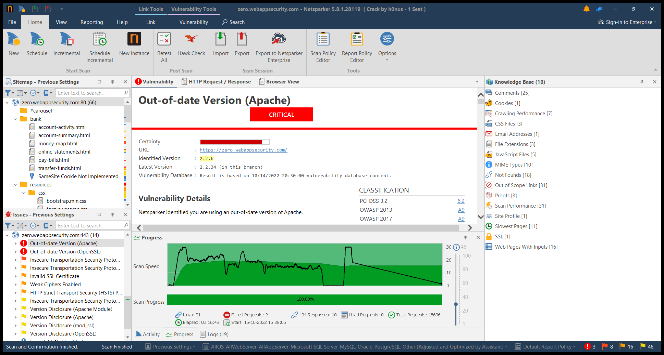
Proof of Concept
Screenshot is attached below

Slide 12
THANK YOU

